Slide 1
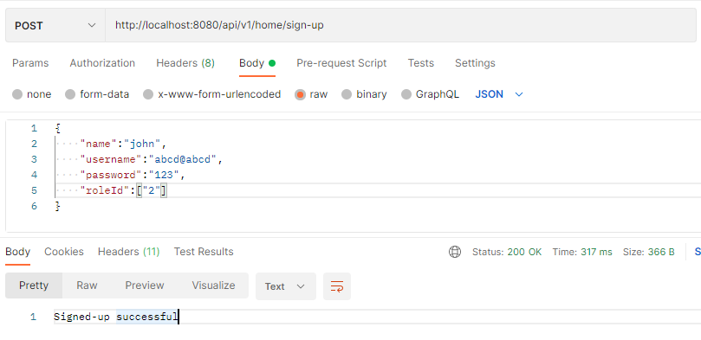
Sign up User

Slide 2
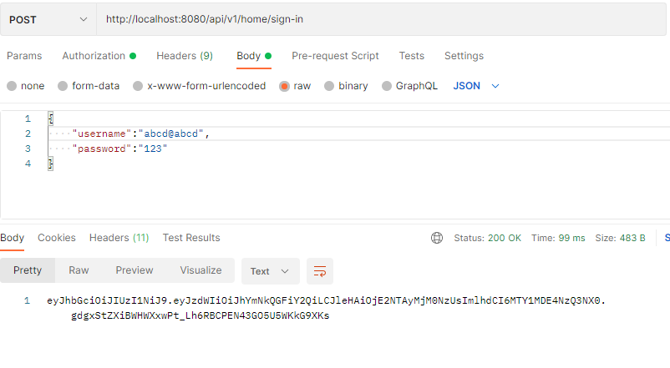
Sign in User

Slide 3
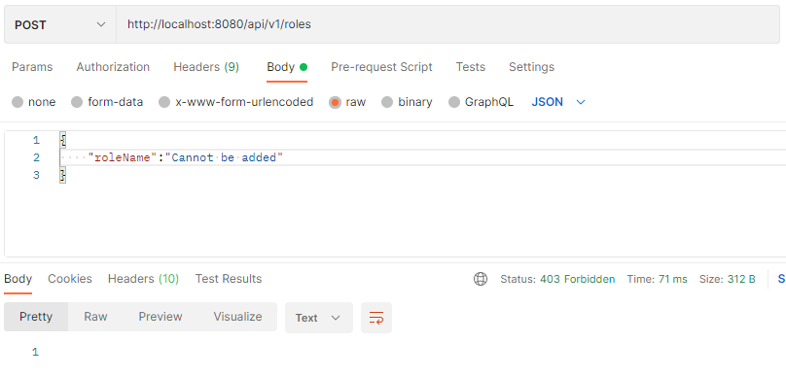
User cannot add a new Role

Slide 4
